Slide 1
Week 10th Database System
MS SQL Server commands
DML (Data Manipulation Language)
DDL (Data Definition Language)
DCL (Data Control Language)
TCL (Transaction Control Language)
MS SQL Server Management Studio (SSMS)

Slide 2
Week 10th Database System
Working with MS SQL Server……
to create objects (tables, constraints, indexes, etc.)
Visual Mode: simply use integrated development environment (IDE) to work with databases and there is no need in studying visual tools for a particular database type (MS SQL, Oracle , MySQL, Firebird, etc.) i.e. convenient because you can see the whole text
Script Mode: constantly working with databases, creating, modifying, and especially rebuilding an object using scripts is much faster than in a visual mode. it is convenient to use scripts when you need to transfer database changes from a test database to a production database

Slide 3
Week 10th Database System
Working with MS SQL Server……
to create objects (tables, constraints, indexes, etc.)
Visual Mode: simply use integrated development environment (IDE) to work with databases and there is no need in studying visual tools for a particular database type (MS SQL, Oracle , MySQL, Firebird, etc.) i.e. convenient because you can see the whole text
Script Mode: constantly working with databases, creating, modifying, and especially rebuilding an object using scripts is much faster than in a visual mode. it is convenient to use scripts when you need to transfer database changes from a test database to a production database

Slide 4
Week 10th Database System
SQL Server commands
What is Transact-SQL?
Structured Query Language (SQL)
Developed by IBM in 1970s
Adopted as a standard by ANSI and ISO standards bodies
Widely used in industry
Microsoft’s implementation is Transact-SQL
Referred to as T-SQL
Query language for SQL Server and Azure SQL Database
SQL is declarative, not procedural
Describe what you want, don’t specify steps
commands or instructions which we are using with queries to communicate with our database

Slide 5

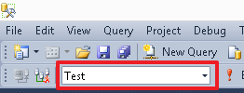
Week 10th Database System
MS SQL Server Management Studio (SSMS)
SQL Server Management Studio (SSMS) is the Microsoft SQL Server utility for configuring, managing and administering database components. It includes a script editor and a graphics program that works with server objects and settings. The main tool of SQL Server Management Studio is Object Explorer, which allows a user to view, retrieve, and manage server objects
How to access or create new Script editor?
To create a new script editor, use the New Query button:
How to select or switch to a particular database?
To switch from the current database, you can use the drop-down menu:

Slide 6
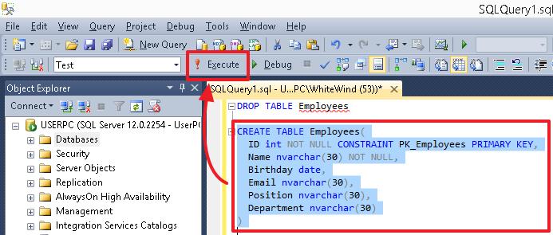
Week 10th Database System
How to execute a command \ query in Script editor?
To execute a particular command or set of commands, highlight it and press the Execute button or F5. If there is only one command in the editor or you need to execute all commands, then do not highlight anything

Slide 7
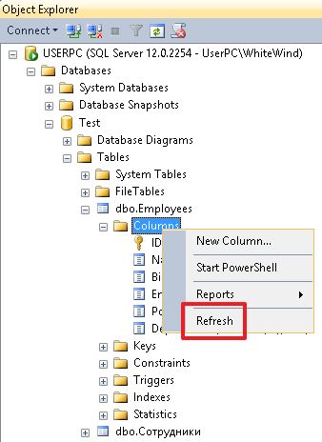
Week 10th Database System
How to refresh to see changes?
select the corresponding object (for example, Tables or Columns) and then click Refresh on the shortcut menu to see the changes

Slide 8
Week 10th Database System
SQL Statement Types
SQL is a language that allows executing queries in databases via DBMS. In a particular DBMS, an SQL language may have its own dialect.
SQL Server commands are grouped in these four main logical groups, and they are:
Data Manipulation Language (DML)
Data Definition Language (DDL)
Data Control Language (DCL)
Transaction Control Language (TCL)
How to use comments in queries?
It is possible to use two types of comments in SQL (single-line and delimited):
-- single-line comment
and
/* delimited comment */

Slide 9
Transact-SQL Data Types
Week 10th Database System
Exact Numeric | Approximate Numeric | Character | Date/Time | Binary | Other
tinyint | float | char | date | binary | cursor
smallint | real | varchar | time | varbinary | hierarchyid
int |  | text | datetime | image | sql_variant
bigint |  | nchar | datetime2 |  | table
bit |  | nvarchar | smalldatetime |  | timestamp
decimal/numeric |  | ntext | datetimeoffset |  | uniqueidentifier
numeric |  |  |  |  | xml
money |  |  |  |  | geography
smallmoney |  |  |  |  | geometry

Slide 10
Week 10th Database System
Definition | Designation in MS SQL | Description
Variable-length string | varchar(N) and nvarchar(N) | Using the N number, we can specify the maximum possible string length for a particular column. For example, if we want to say that the value of the Full Name column can contain 30 symbols (at the most), then it is necessary to specify the type of nvarchar(30). The difference between varchar from nvarchar is that varchar allows storing strings in the ASCII format, while nvarchar stores strings in the Unicode format, where each symbol takes 2 bytes. I recommend using the varchar type only if you are sure that you will not need to store the Unicode symbols in the given field. For example, you can use varchar to store email contacts.

Slide 11
Week 10th Database System
Definition | Designation in MS SQL | Description
Fixed-length string | char(N) and nchar(N) | This type differs from the variable-length string in the following: if the string length is less than N symbols, then spaces are always added to the N length on the right. Thus, in a database, it takes exactly N symbols, where one symbol takes 1 byte for char and 2 bytes for nchar. In my practice, this type is not used much. Still, if anyone uses it, then usually this type has the char(1) format, i.e when a field is defined by 1 symbol.
Integer | int | This type allows us to use only integer (both positive and negative) in a column. Note: a number range for this type is as follows: from 2 147 483 648 to 2 147 483 647. Usually, it is the main type used to вуашту identifiers.

Slide 12
Week 10th Database System
Definition | Designation in MS SQL | Description
Floating-point number | float | Numbers with a decimal point.
Date | date | It is used to store only a date (date, month, and year) in a column. For example, 02/15/2014. This type can be used for the following columns: receipt date, birthdate, etc., when you need to specify only a date or when time is not important to us and we can drop it.
Time | time | You can use this type if it is necessary to store time: hours, minutes, seconds, and milliseconds. For example, you have 17:38:31.3231603 or you need to add the flight departure time.
Date and time | datetime | This type allows users to store both date and time. For example, you have the event on 02/15/2014 17:38:31.323.
Indicator | bit | You can use this type to store values such as ‘Yes’/’No’, where ‘Yes’ is 1, and ‘No’ is 0.

Slide 13
Working with NULLs
Week 10th Database System
NULL represents a missing or unknown value
ANSI behaviour for NULL values:
The result of any expression containing a NULL value is NULL
2 + NULL = NULL
‘MyString: ‘ + NULL = NULL
Equality comparisons always return false for NULL values
NULL = NULL returns false
NULL IS NULL returns true
NULL Functions
ISNULL(column/variable, value)
Returns value if the column or variable is NULL
NULLIF(column/variable, value)
Returns NULL if the column or variable is value
COALESCE (column/variable1, column/variable2,…)
Returns the value of the first non-NULL column or variable in the list

Slide 14
Working with NULLs
Week 10th Database System
NULL represents a missing or unknown value
ANSI behaviour for NULL values:
The result of any expression containing a NULL value is NULL
2 + NULL = NULL
‘MyString: ‘ + NULL = NULL
Equality comparisons always return false for NULL values
NULL = NULL returns false
NULL IS NULL returns true
NULL Functions
ISNULL(column/variable, value)
Returns value if the column or variable is NULL
NULLIF(column/variable, value)
Returns NULL if the column or variable is value
COALESCE (column/variable1, column/variable2,…)
Returns the value of the first non-NULL column or variable in the list

Slide 15
Week 10th Database System
DDL (Data Definition Language)
DDL commands we use for definition and creation objects in database (Table, Procedure, Views...).
These commands are mainly used for design and definition the structure of our database.
DDL commands are:
CREATE - we can create a new table, database, procedure, view, trigger...
ALTER - usually we use for editing database objects (table, procedure, view...) for example, add or delete column from table
DROP - we use for deleting database objects e.g. table, database, procedure, view, trigger...
Rename- is used to rename an object existing in database.
Examples:
How to create, Drop and use a database?
To create a simple database without any additional properties, run the following command:
CREATE DATABASE Test
To delete a database, execute this command:
DROP DATABASE Test
To switch to our database, use the command:
USE Test

Slide 16
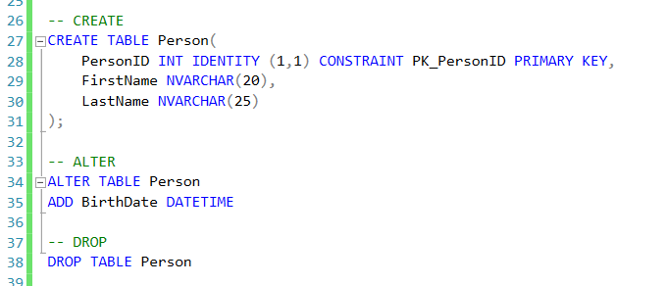
Week 10th Database System
DDL commands (cont ….)
How to create, Drop and alter a table in database?
USE Test
CREATE TABLE Employees (
ID int,
Name nvarchar(30),
Birthday date,
Email nvarchar(30),
Position nvarchar(30),
Department nvarchar(30)
)

Slide 17
Week 10th Database System
DDL commands (cont ….)
How to alter (alter, Add and drop) and drop a table in database?
For the current table, you can redefine the fields using the following commands:
-- ID field update
USE Test
ALTER TABLE Employees ALTER COLUMN ID int NOT NULL
-- Name field update
ALTER TABLE Employees ALTER COLUMN Name nvarchar(30) NOT NULL
--use the following command to create a primary key for the table:
ALTER TABLE Employees ADD CONSTRAINT PK_Employees PRIMARY KEY(ID)
OR ALTER TABLE table_name ADD CONSTRAINT constraint_name PRIMARY KEY(field1,field2,…)
-- to drop a constraint
ALTER TABLE Employees DROP CONSTRAINT PK_Employees
-- to drop employee
DROP TABLE [Employees]

Slide 18
Week 10th Database System
Create a foreign key in a new table Using Transact-SQL
The following example creates a table and defines a foreign key constraint on the column TempID that references the column SalesReasonID in the Sales.SalesReason table in the AdventureWorks database. The ON DELETE CASCADE and ON UPDATE CASCADE clauses are used to ensure that changes made to Sales.SalesReason table are automatically propagated to the Sales.TempSalesReason table.
CREATE TABLE Sales.TempSalesReason (
TempID int NOT NULL, Name nvarchar(50)
, CONSTRAINT PK_TempSales PRIMARY KEY NONCLUSTERED (TempID)
, CONSTRAINT FK_TempSales_SalesReason FOREIGN KEY (TempID)
REFERENCES Sales.SalesReason (SalesReasonID)
ON DELETE CASCADE
ON UPDATE CASCADE
);
Create a foreign key in an existing table
The following example creates a foreign key on the column TempID and references the column SalesReasonID in the Sales.SalesReason table in the AdventureWorks database.
ALTER TABLE Sales.TempSalesReason ADD CONSTRAINT FK_TempSales_SalesReason FOREIGN KEY (TempID) REFERENCES Sales.SalesReason (SalesReasonID) ON DELETE CASCADE ON UPDATE CASCADE ;

Slide 19
Week 10th Database System
Unique and Check Constraint
UNIQUE constraints and CHECK constraints are two types of constraints that can be used to enforce data integrity in SQL Server tables. These are important database objects
Unique Constraint
use a UNIQUE constraint instead of a PRIMARY KEY constraint when you want to enforce the uniqueness of a column, or combination of columns, that is not the primary key
UNIQUE constraints allow for the value NULL
can be referenced by a FOREIGN KEY constraint
The Database Engine automatically creates a UNIQUE index (nonclustered) to enforce the uniqueness requirement of the UNIQUE constraint
if an attempt to insert a duplicate row is made, the Database Engine returns an error message that states the UNIQUE constraint has been violated and does not add the row to the table
To create a unique constraint on an existing table
USE AdventureWorks2012;
GO
ALTER TABLE Person.Password
ADD CONSTRAINT AK_Password UNIQUE (PasswordHash, PasswordSalt);
GO

Slide 20
Week 10th Database System
Check Constraint
CHECK constraints enforce domain integrity by limiting the values that are accepted by one or more columns. You can create a CHECK constraint with any logical (Boolean) expression that returns TRUE or FALSE based on the logical operators
CHECK constraints are similar to FOREIGN KEY constraints in that they control the values that are put in a column. The difference is in how they determine which values are valid: FOREIGN KEY constraints obtain the list of valid values from another table, while CHECK constraints determine the valid values from a logical expression
A CHECK constraint works at the row level.
A CHECK constraint returns TRUE when the condition it is checking is not FALSE for any row in the table
CHECK constraints are not validated during DELETE statements.
Example
the range of values for a salary column can be limited by creating a CHECK constraint that allows for only data that ranges from $15,000 through $100,000 logical expression would be the following:
salary >= 15000 AND salary <= 100000.
ALTER TABLE Employee
ADD CONSTRAINT chksal CHECK (salary >= 15000 AND salary <= 100000);
GO

Slide 21
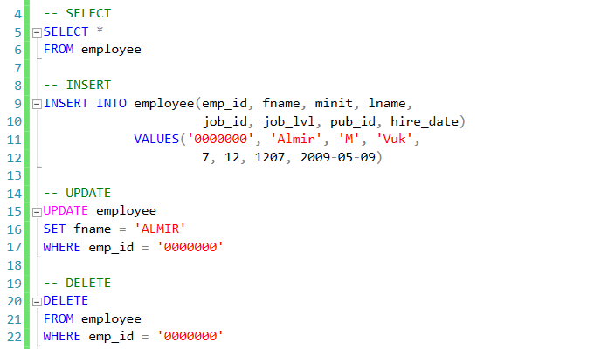
Week 10th Database System
DML—Data Manipulation Language
DML commands are mainly used for manipulation with the records in our table, so with them, we can select/read data with some criteria or not, we can insert new data or edit existing ones... and of course we can delete records if we don't need them anymore.
DML commands are:
SELECT - select/read records from table in our database,
INSERT - we can insert new records in our table,
UPDATE - edit/update existing records,
DELETE - delete existing records in our table
Example:

Slide 22
The SELECT Statement
Week 10th Database System
Element | Expression | Role
SELECT | <select list> | Defines which columns to return
FROM | <table source> | Defines table(s) to query
WHERE | <search condition> | Filters rows using a predicate
GROUP BY | <group by list> | Arranges rows by groups
HAVING | <search condition> | Filters groups using a predicate
ORDER BY | <order by list> | Sorts the output
5
1
2
3
4
6
SELECT OrderDate,
COUNT(OrderID)
FROM Sales.SalesOrder
WHERE Status = 'Shipped'
GROUP BY OrderDate
HAVING COUNT(OrderID) > 1
ORDER BY OrderDate DESC;

Slide 23
Basic SELECT Query Examples
Week 10th Database System
All columns
Specific columns
Expressions and Aliases
SELECT * FROM Production.Product;
SELECT Name, ListPrice
FROM Production.Product;
SELECT Name AS Product, ListPrice * 0.9 AS SalePrice
FROM Production.Product;

Slide 24
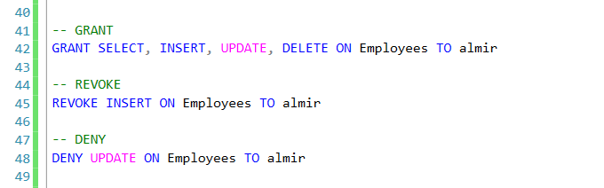
Week 10th Database System
Data Control Language – DCL
DCL commands are used for access control and permission management for users in our database. With them we can easily allow or deny some actions for users on the tables or records (row level security).
DCL commands are:
GRANT - we can give certain permissions on the table (and other objects) for certain users of database,
DENY - bans certain permissions from users.
REVOKE - with this command we can take back permission from users.
Example of usage of these commands are in this image here:

Slide 25
Week 10th Database System
GRANT in first case we gave privileges to user Almir to do SELECT, INSERT, UPDATE and DELETE on the table called employees.
REVOKE with this command we can take back privilege to default one... in this case, we take back command INSERT on the table employees for user Almir.
DENY is a specific command. We can conclude that every user has a list of privilege which is denied or granted so command DENY is there to explicitly ban you some privileges on the database objects

Slide 26
Week 10th Database System
TCL (Transaction Control Language)
With TCL commands we can mange and control T-SQL transactions so we can be sure that our transaction is successfully done and that integrity of our database is not violated.
TCL commands are:
BEGIN TRAN - begin of transaction
COMMIT TRAN - commit for completed transaction
ROLLBACK - go back to beginning if something was not right in transaction.

Slide 27
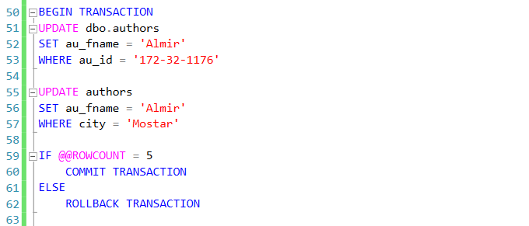
Week 10th Database System
On this image we have simple example of these three commands combined in one transaction. With BEGIN TRANSACTION obviously we will begin our transaction, as we can see we will update some author with some value of ID... query is more or less clear and the important part is IF-ELSE part of query. If we affect five rows with our first query than we will COMMIT this transaction. Obviously we will not affect five rows, so we will affect one row for this reason we will not go into the IF part but we will go into the ELSE part so our transaction will be returned to beginning state because it will trigger ROLLBACK command and everything that happened in UPDATE it will be undone.

Slide 28
Week 10th Database System
01.TRANSACTION T1; -- Transaction can be insert, update or delete
02.
03.SAVEPOINT S1;
04.TRANSACTION T2;
05.SAVEPOINT S2;
06.TRANSACTION T3;
07.SAVEPOINT S3;
08.TRANSACTION T4;
09.ROLLBACK TO S1; -- This will rollback all the changes by T1 and T2 and will have only the changes done on T1
AUTOCOMMIT : AUTOCOMMIT command automatically commits each transaction after its execution. If this command is set, then no need to explicitly issue commit. We cannot rollback our transactions, if AUTOCOMMIT is on. This needs to be set /unset before we begin any transactions.
SAVEPOINT:
Suppose there are set of update, delete transactions performed on the tables. But there are some transactions which we are very sure about correctness. After that set of transactions we are uncertain about the correctness. So what we can do here is we can set a SAVEPOINT at the correct transaction telling the database that, in case of rollback, rollback till the savepoint marked. Hence the changes done till savepoint will be unchanged and all the transactions after that will be rolled back. In the case of multiple transactions, savepoint can be given after each transactions and transaction can be rolled back to any of the transactions.

